Slide 1
Data Visualization
with Plotly for JavaScript
Pamela Pan, Data Services Fellow
pp1813@nyu.edu
Fall 2021, NYU Shanghai Library

Slide 2
Timeline
Data Visualization Series
Data Visualization with Plotly for JavaScript
October 21, 2021
10-11:30 am (90 min)
AB Room 415
Intro to Data Visualization on Web Interfaces
October 15, 2021
9:30-10:30 am (60 min)
AB Room 415
Data Visualization with Plotly for Python
Data Dashboarding with Plotly for
Python
October 21, 2021
10-11:30 am (90 min)
AB Room 415
October 28, 2021
10 am -12 pm (120 min)
AB Room 415

Slide 3
Before we start
Open tinyurl.com/datavizworkshops
Go to “Workshop 10-22”

Slide 4
Workflow
Part I: Build the Basics
● Why React, Why Plotly
● 5-step Set Up
● Git & GitHub
● React Basics
Part II: Let’s Visualize!
● Components & Data
● Visualize medals data
● Explore: GDP and Medals
Part I: The Basics
Part II: Let’s Visualize!
React & Plotly
Set Up
Git & GitHub
React Basics
Components & Data
Visualize medals
GDP & Medals

Slide 5


● Why React, Why Plotly
React is a JavaScript library for building user interfaces.
Declarative, easier to debug
Component-based, reusable
Ideally, we want to build single-responsibility, small components
Fast, precise performance
Still using HTML, CSS, JS, but more efficiently
Plotly is a graphing library that binds to many languages, including JavaScript (read more from last workshop).
Built on D3.js, high interactivity by default
High-level library → Allows concision in code
Interactive, scientific charts
Part I: The Basics
Part II: Let’s Visualize!
React & Plotly
Set Up
Git & GitHub
React Basics
Components & Data
Visualize medals
GDP & Medals

Slide 6
● 5-Step Set Up — Goal
To run the project locally, you will be cloning a GitHub repository (repo) to your local computer instead of creating a React App from the ground up,
The cloned repo contains a React app with 2 basic graph components, our task today is to modify the code and make more sophisticated graphs.
To clone the repo and start running the React App, you will first need to install some softwares and set things up.
Part I: The Basics
Part II: Let’s Visualize!
React & Plotly
Set Up
Git & GitHub
React Basics
Components & Data
Visualize medals
GDP & Medals

Slide 7
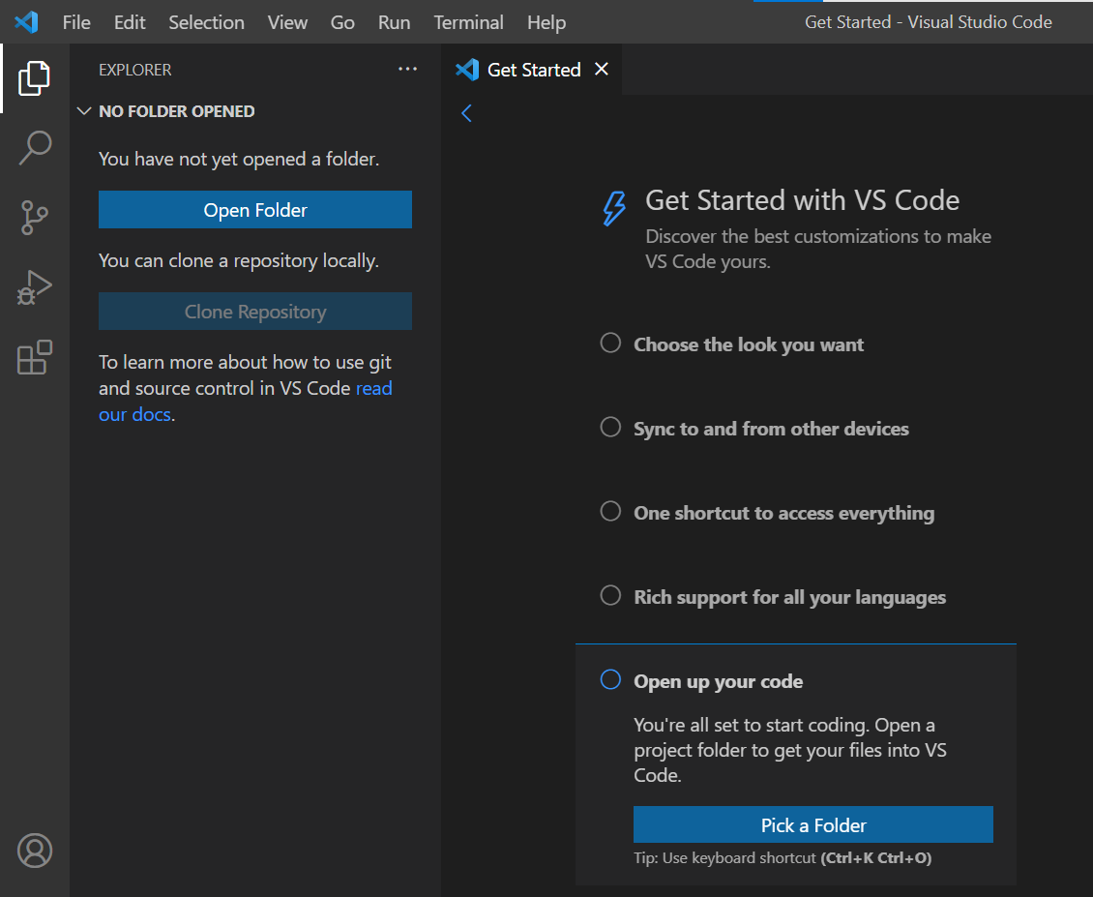
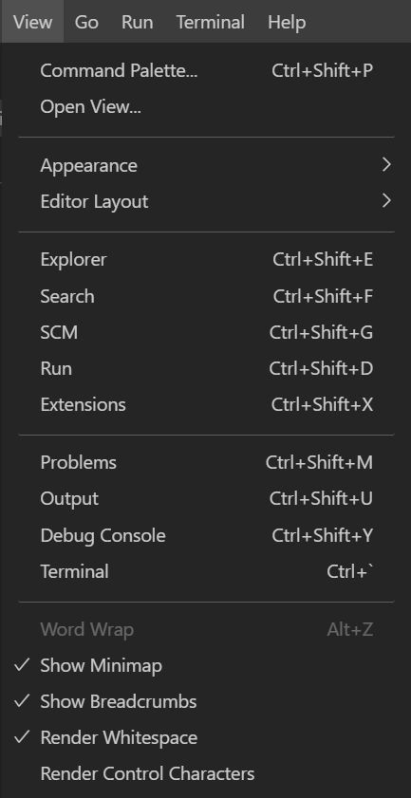
● 5-Step Set Up — Coding Environment (IDE)
Create a GitHub Account if you don’t have one (2 min)
Visual Studio Code: Download & Initialize (5 min)
3. Command Palette
Choose a color scheme of your preference
Sync with other devices, log in with GitHub
Enable Command Palette shortcuts
Open “View” - “Command Palette”
Try searching “view toggle” make Activity Bar invisible
Install language Extensions to save us time when coding
Search “JavaScript Snippets” in Extensions, install it
Search “ES7 React Snippets” in Extensions, install it
Open code by creating/ picking a folder
1. 2.
3.
4.
5.
4. Extensions
Part I: The Basics
Part II: Let’s Visualize!
React & Plotly
Set Up
Git & GitHub
React Basics
Components & Data
Visualize medals
GDP & Medals

Slide 8
● 5-Step Set Up — Node and NPM
Install Node.js to get NPM (3 min)
NPM = Node Package Manager
How to see if your computer is 32-bit / 64-bit?
Windows: System Information - System Type (x64 = 64-bit)
Mac: Apple Menu - About this mac - Processor - 64-bit unless the Processor is Intel Core Solo/ Duo
Part I: The Basics
Part II: Let’s Visualize!
React & Plotly
Set Up
Git & GitHub
React Basics
Components & Data
Visualize medals
GDP & Medals

Slide 9
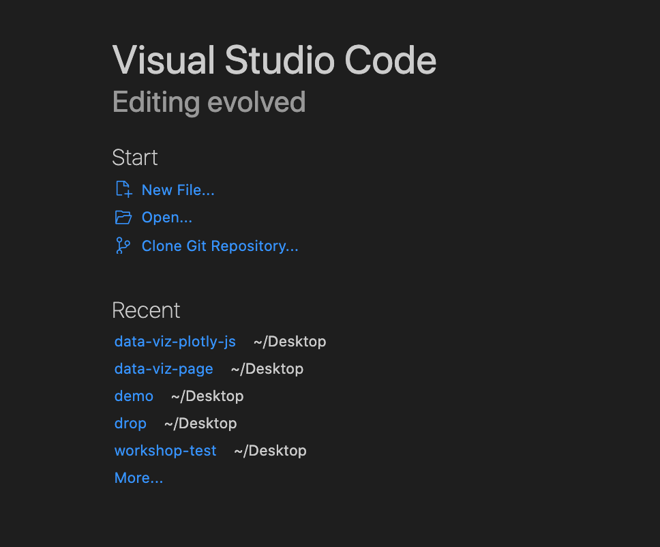
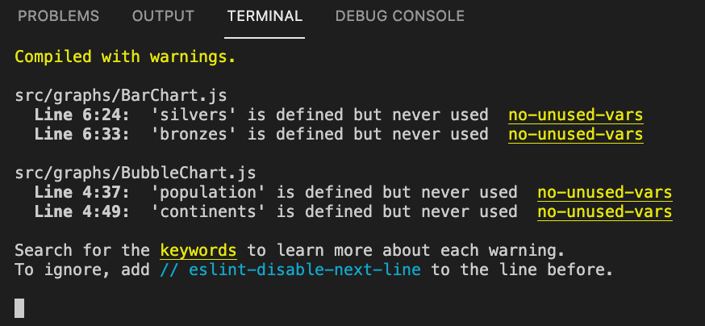
● 5-Step Set Up — Git & GitHub
Install Git, the version control software (2min)
Clone GitHub Repository (make sure you’re logged in w/ GitHub)
Our repo link:
https://github.com/pamela-pan/data-viz-plotly-js.git
In “Get Started”, click Clone Repository - Enter repo link
Or copy the following into terminal:
git clone https://github.com/pamela-pan/data-viz-plotly-js.git
Choose a folder, open it when you’re done cloning
Enter pwd in terminal (pwd = “print working directory”)
Make sure you’re on data-viz-plotly-js, if not,
type cd data-viz-plotly-js (cd = “change directory”)
npm install (2min)
npm start (1~2min)
When you’re done, you should see this in your terminal
Part I: The Basics
Part II: Let’s Visualize!
React & Plotly
Set Up
Git & GitHub
React Basics
Components & Data
Visualize medals
GDP & Medals

Slide 10
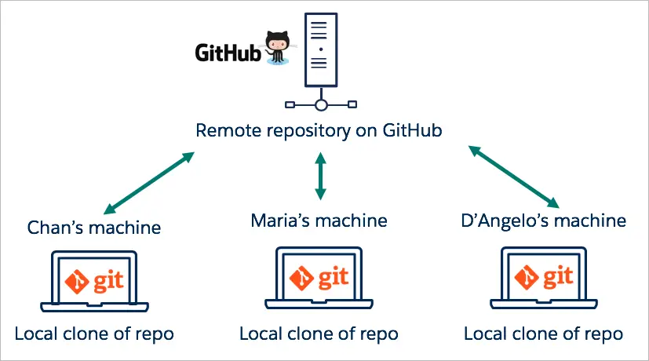
● Understanding Git & GitHub
If you want to create and upload onto your own repo afterwards, check the tutorial here.
Part I: The Basics
Part II: Let’s Visualize!
React & Plotly
Set Up
Git & GitHub
React Basics
Components & Data
Visualize medals
GDP & Medals
Notes:
Perfect for teamwork, or continuing from someone’s project, which is the case today

Slide 11
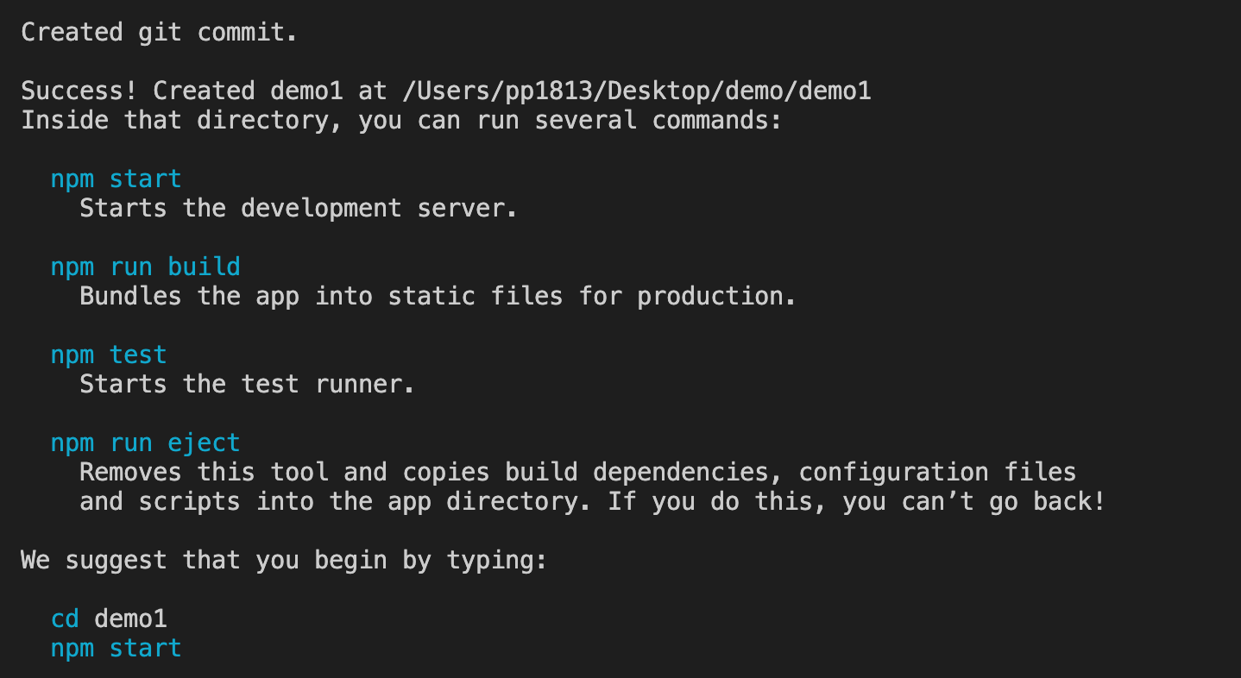
● React Basics
How to create a new app?
*For your reference, no need to create one for this workshop*
Create/ Open a root folder (Desktop is fine)
Create and give a name for the app
npx create-react-app name
Run the app
cd name
npm start
When you’re done, you should see this in your terminal
Case in which the
app name is “demo1”
Part I: The Basics
Part II: Let’s Visualize!
React & Plotly
Set Up
Git & Github
React Basics
Components & Data
Visualize medals
GDP & Medals
Notes:
We’re not going to create one today
This is for your reference only
Just in case you’re wondering what a react app looks like by default..

Slide 12
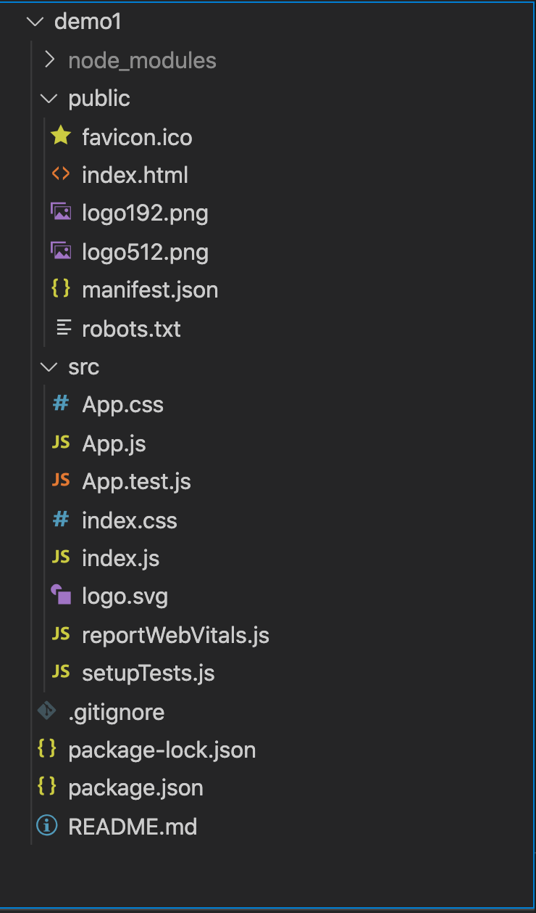
● React Basics
Default setup
Main component: src - App.js
Where is it? public - index.html, in a div called “root”
How does it work? src - index.js
JavaScript file, but different syntax -- JSX
package.json
Where all our dependencies are stored
package-lock.json
Automatically generated with any npm commands
Files for advanced usage/ default app (delete if not necessary)
The logo files
App.test.js
reportWebVitals.js
Part I: The Basics
Part II: Let’s Visualize!
React & Plotly
Set Up
Git & Github
React Basics
Components & Data
Visualize medals
GDP & Medals

Slide 13
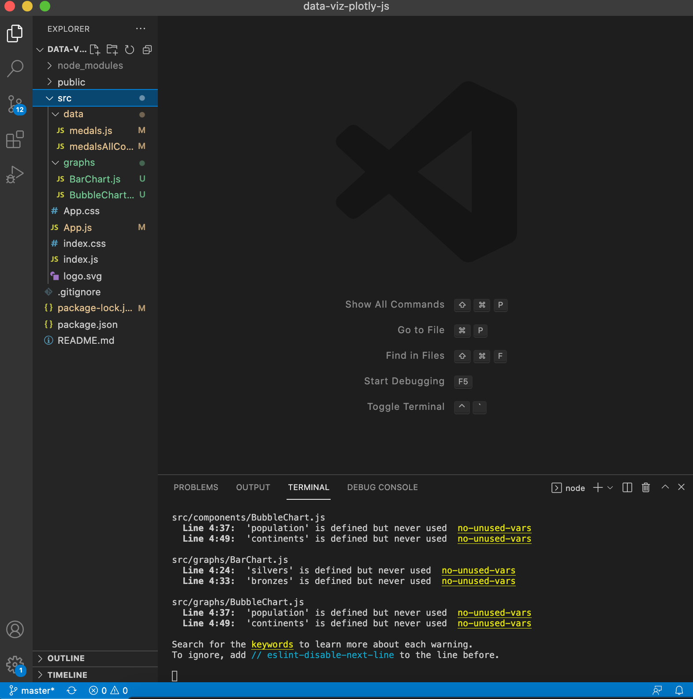
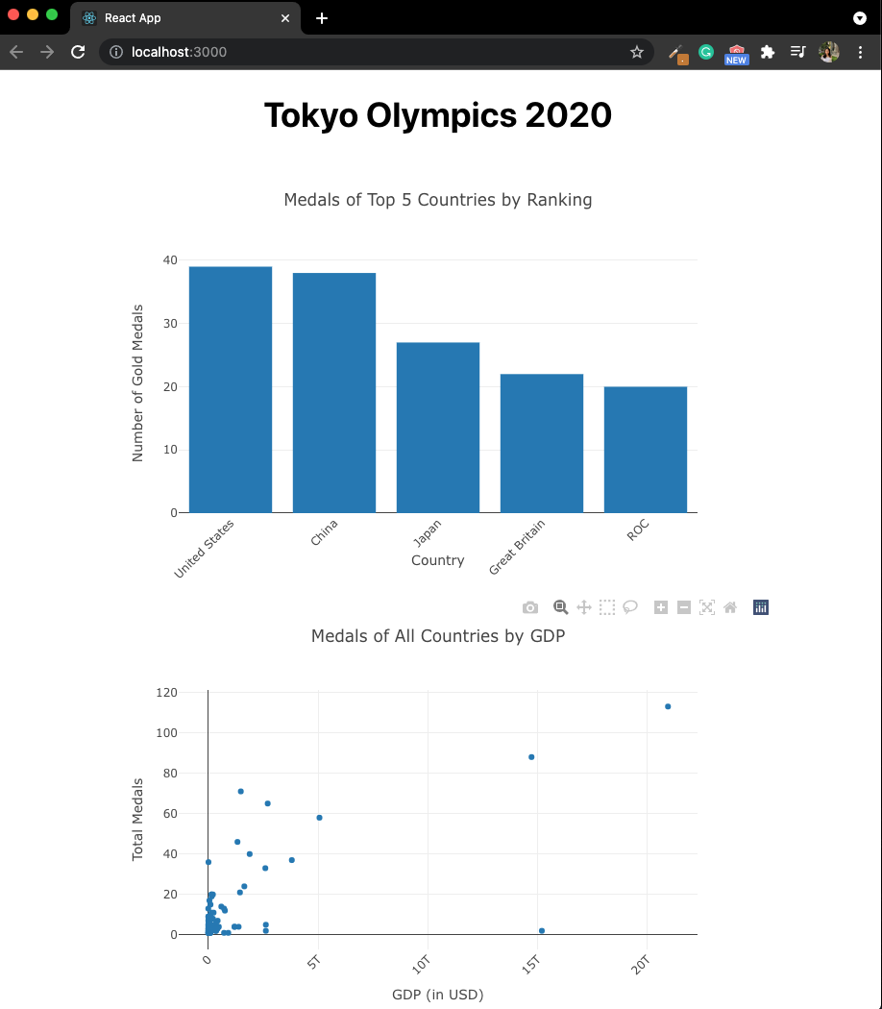
Let’s open today’s working directory:
data-viz-plotly-js
Haven’t started your app?
Open your terminal and type:
cd data-viz-plotly-js
npm install
npm start
VS Code view
Browser view
Notes:
Our react app in code and in browser.

Slide 14
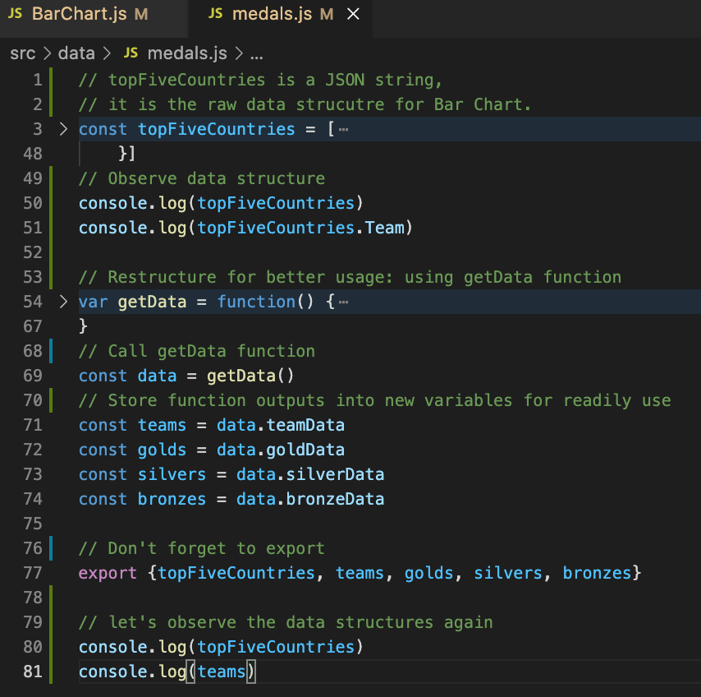
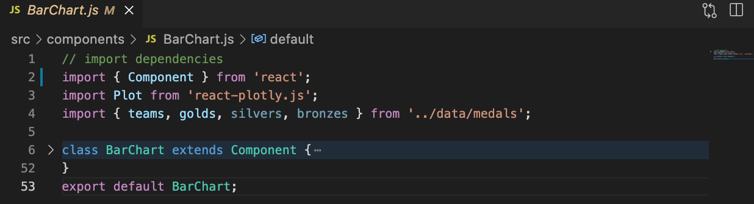
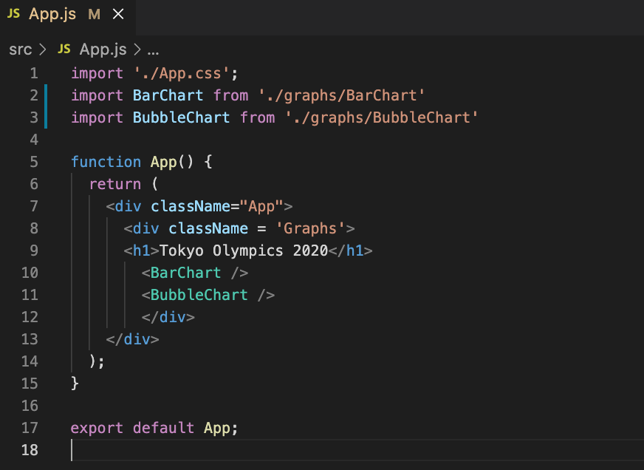
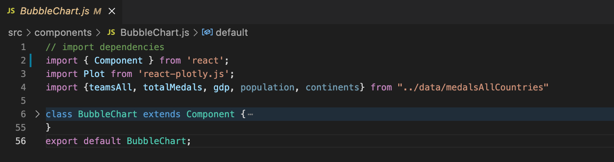
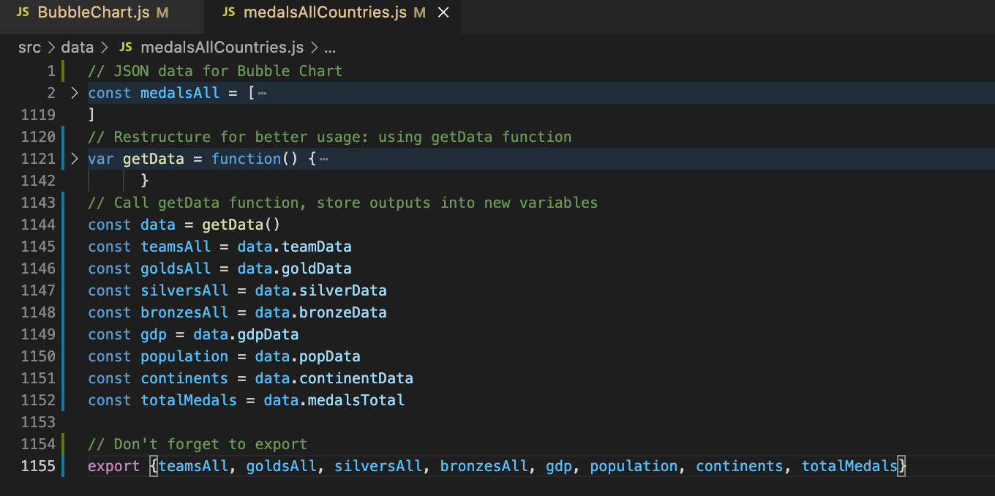
● Components & Data
Data (JS):
constants (const)
Graphs (React components):
class
Main app (React component):
function
Part I: The Basics
Part II: Let’s Visualize!
React & Plotly
Set Up
Git & Github
React Basics
Components & Data
Visualize medals
GDP & Medals

Slide 15
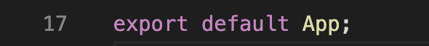
● Export statements
Data (JS):
constants (const)
Graphs (React components):
class
Main app (React component):
function
Multiple constants (JS objects),
curly brackets needed for specification.
Default = component as a single whole,
no curly brackets needed.
Part I: The Basics
Part II: Let’s Visualize!
React & Plotly
Set Up
Git & Github
React Basics
Components & Data
Visualize medals
GDP & Medals
Notes:
Since our App.js file only has one function object, we could just do export default,
Same for BarChart.js and BubbleChart.js, each with one class in its file
However, in our data files, there are multiple const objects, so we would want to export them separately for more convenient usage.
You can imagine the case where you only export one default object that contains all of these separate constants, it would be cumbersome to index or get a specific object.

Slide 16
● Import statements
Data (JS):
constants (const)
*Since we’re using ES7, we can write React JSX without “import React from ‘react’ “
Graphs (React components):
class
Main app (React component):
function
If there are multiple objects,
curly brackets are needed for specification.
If there is only 1 object in the component, no curly brackets needed.
Part I: The Basics
Part II: Let’s Visualize!
React & Plotly
Set Up
Git & Github
React Basics
Components & Data
Visualize medals
GDP & Medals

Slide 17
● Function VS Class Components
Graphs (React components):
class
Main app (React component):
function
Function components
Simple
Takes in props
Stateless*
Class components
Complex, rich
Maintain their private data - state
Takes in props
Good for the purpose of our graphs
*More about React state
Part I: The Basics
Part II: Let’s Visualize!
React & Plotly
Set Up
Git & Github
React Basics
Components & Data
Visualize medals
GDP & Medals
Notes:
About React state management

Slide 18
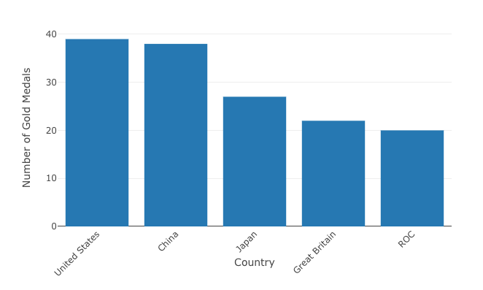
● Visualize Medals of Top-5 Countries - Bar Chart
We will start with a basic bar chart that only graphs gold medals data.
Task 1: Add on Silver and Bronze medals data by creating a stacked bar chart
Look at Bar Charts page*
*demo code in the Plotly.js documentation
Task 2: Restyle the bars
View Styling Markers page
Task 3: Add axes labels and title
View Axes - Set Styles and Axis Labels
React Plotly.js doc | GitHub
Part I: The Basics
Part II: Let’s Visualize!
React & Plotly
Set Up
Git & Github
React Basics
Components & Data
Visualize medals
GDP & Medals
Notes:
Key thing to note: although plotly.js documentation is written in purely js, but how they define their traces, and layout, is also using plotly json

Slide 19
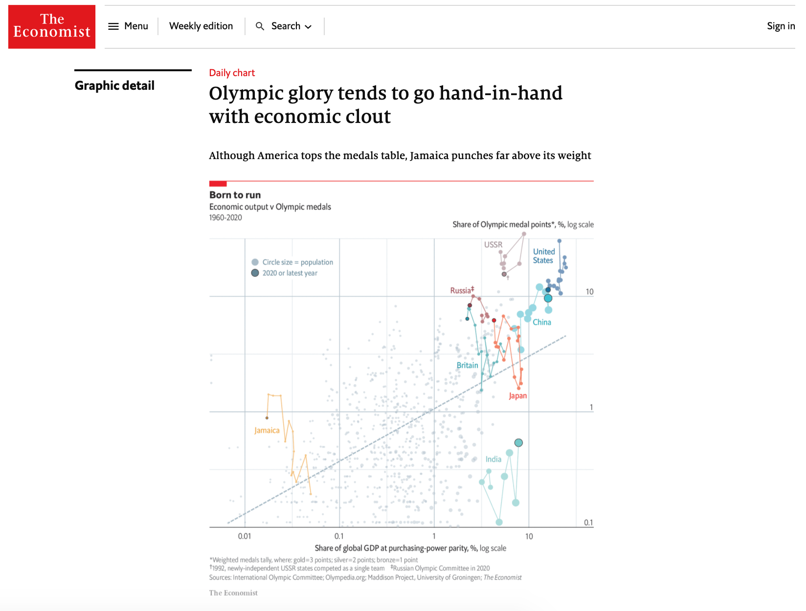
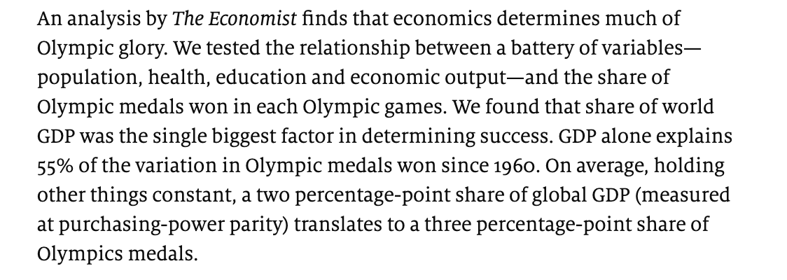
● Visualize GDP and Medals Data - Motivation
This Article suggests possible connection between economic output and Olympic glory.
Let’s make our own visualization* with the latest data
Economic output -> GDP (most recent year)
Olympic performance -> Tokyo 2020 Medals
*Our goal is to generate hypothesis for further research, not conclusions
Part I: The Basics
Part II: Let’s Visualize!
React & Plotly
Set Up
Git & Github
React Basics
Components & Data
Visualize medals
GDP & Medals
Notes:
In plotly graphing, data points are referred to as markers.

Slide 20
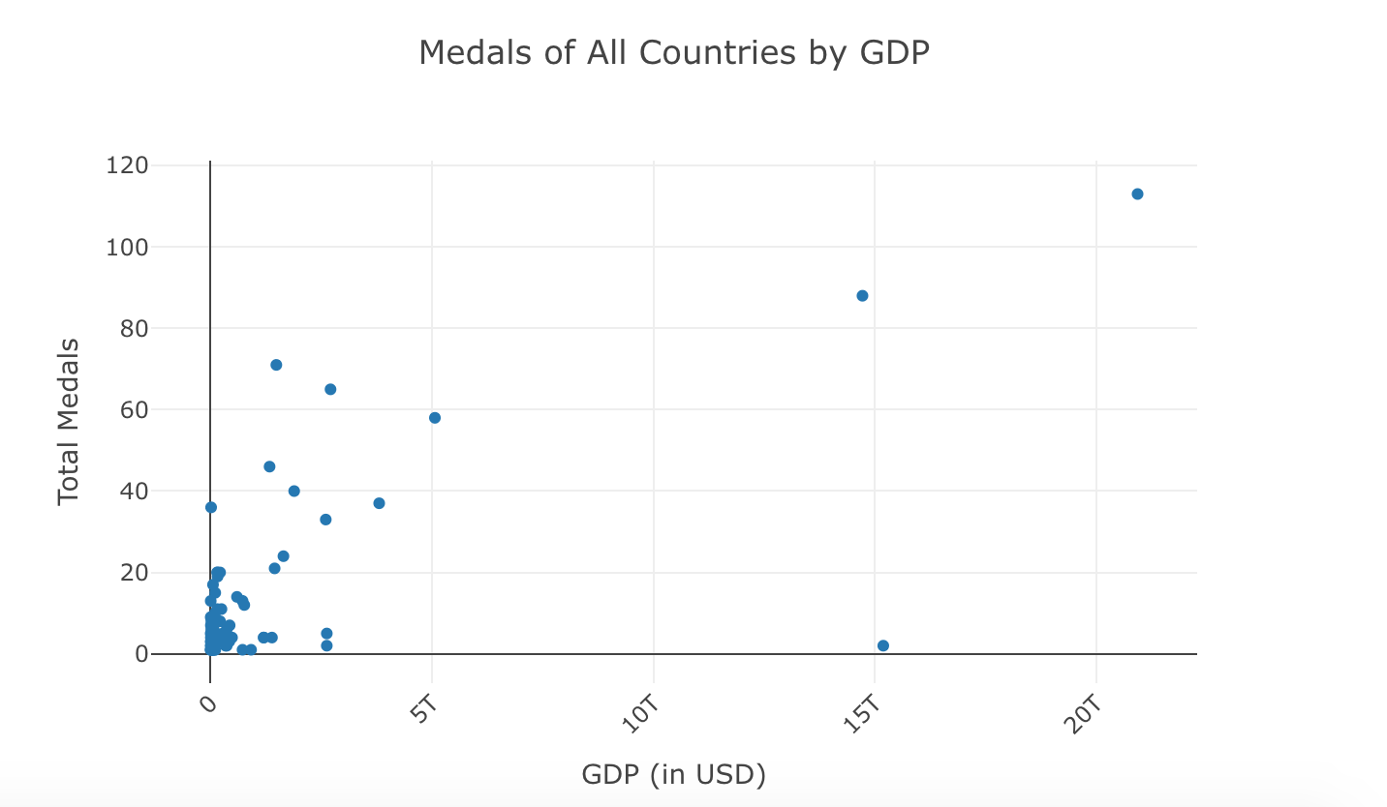
● Visualize GDP and Medals Data - Bubble Chart
We will start with a basic scatter chart.
Task 1: Add size to data points
Look at Bubble Charts page
Task 2: Add color by continents
View Transform - Groupby page
Task 3: Set X-axis as log scale to declutter the view
View Axes - Log Axes
Task 4: Add range (logged)
View Figure Reference - Range
Part I: The Basics
Part II: Let’s Visualize!
React & Plotly
Set Up
Git & Github
React Basics
Components & Data
Visualize medals
GDP & Medals
Notes:
In plotly graphing, data points are referred to as markers.

Slide 21
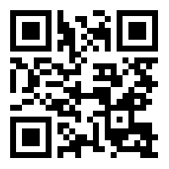
Thank you!
Contact: Pamela Pan (pp1813@nyu.edu)
Data Services Fellow, NYU Shanghai Library
Other workshop resources:
👉 http://shanghai.hosting.nyu.edu/data/
Feedback form
tinyurl.com/libworkshopfeedback

